Slide 1
Chapter 10

Slide 2
Objectives

Slide 3
Objectives (cont.)

Slide 4
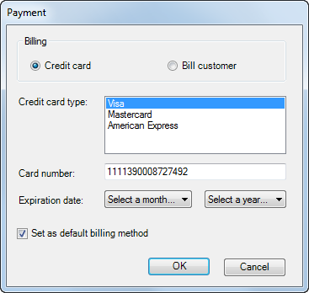
A form with five more types of controls

Slide 5
Common members of list box and combo box controls

Slide 6
Common properties of the Items collection
Notes:
[index] = array position

Slide 7
Code that loads a combo box with months

Slide 8
Code that loads a combo box with years

Slide 9
Code that clears and loads a list box of credit cards

Slide 10
Code that works with a combo box of names

Slide 11
A group box that contains two radio buttons

Slide 12
Code that sets the value of a radio button and check box

Slide 13
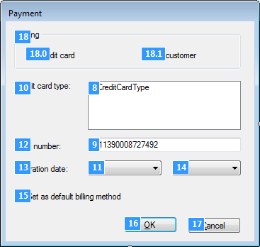
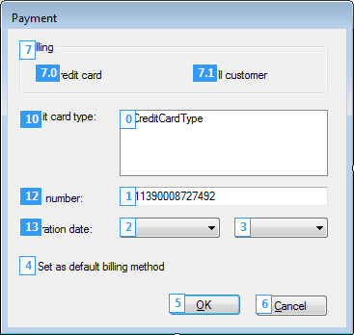
A form in Tab Order view before and after the tab order is changed

Slide 14
How to use Tab Order view

Slide 15
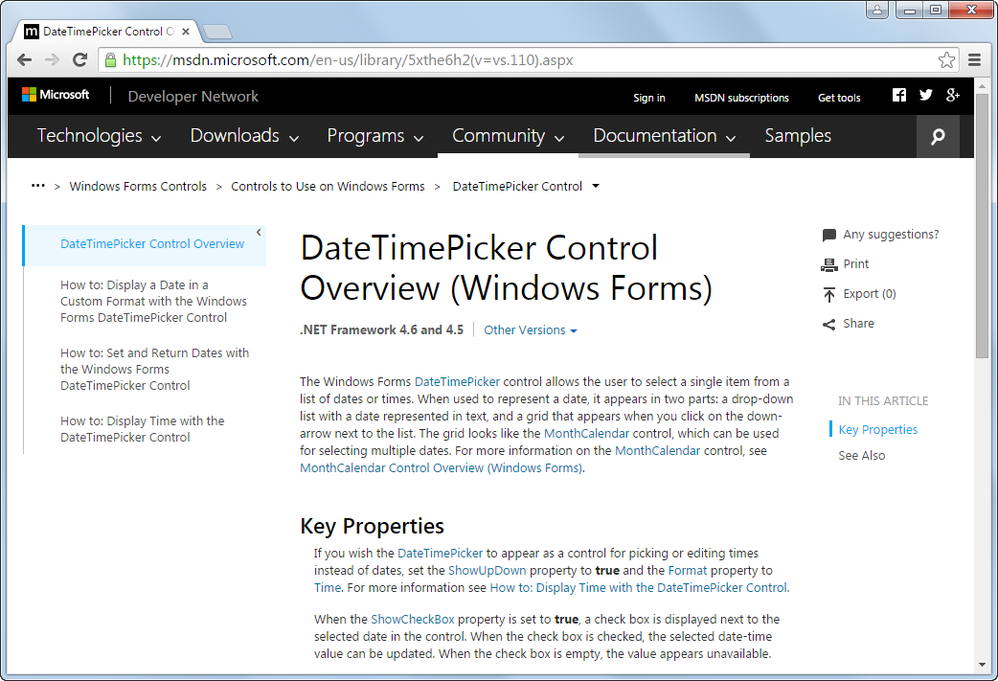
Help for the DateTimePicker control

Slide 16
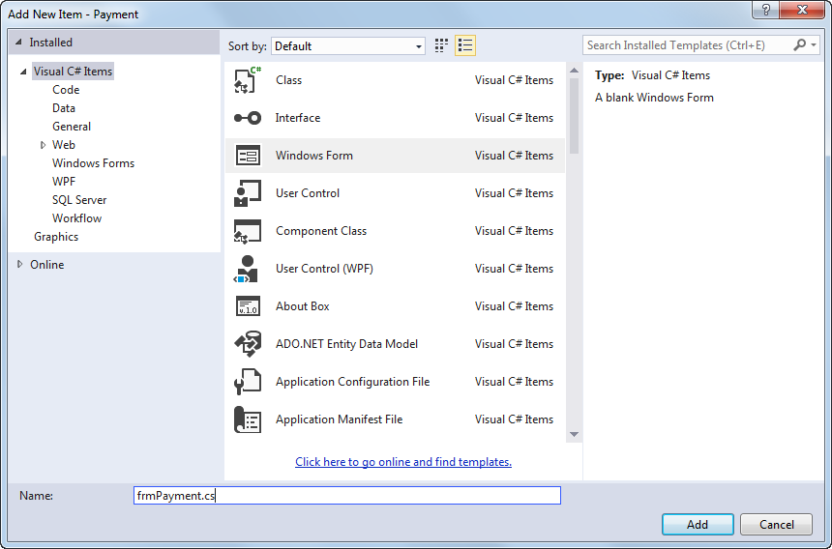
The Add New Item dialog box

Slide 17
How to add a new form

Slide 18
How to add an existing form

Slide 19
The generated code for a new form named frmPayment

Slide 20
The code that’s generated for the Load event handler of the form

Slide 21
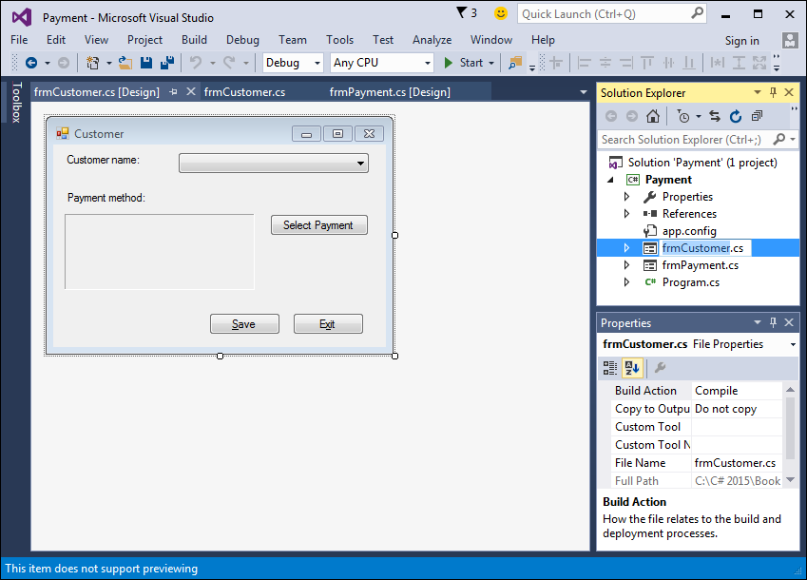
A project that contains two forms

Slide 22
How to change the name of a form

Slide 23
Code that defines the main entry point for an application

Slide 24
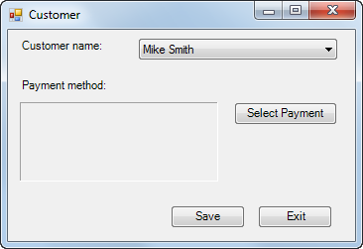
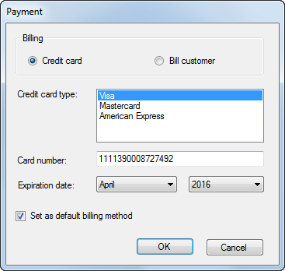
The Payment form displayed as a dialog box

Slide 25
Properties for creating custom dialog boxes

Slide 26
Code that creates and displays a custom dialog box

Slide 27
An enumeration that works with dialog boxes

Slide 28
A statement that sets the DialogResult property of a form

Slide 29
How to use the DialogResult enumeration

Slide 30
How to use the Tag property

Slide 31
The syntax for the Show method of the MessageBox class

Slide 32
A statement that displays a dialog box and gets the user response

Slide 33
A statement that checks the user response

Slide 34
The code for a dialog box that cancels the Closing event

Slide 35
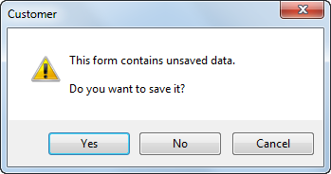
The dialog box that’s displayed

Slide 36
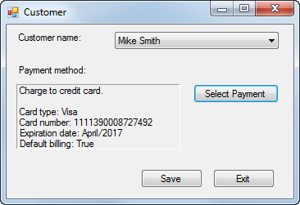
The Customer form

Slide 37
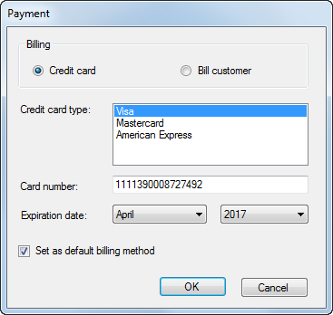
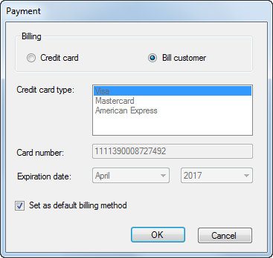
Two versions of the Payment dialog box

Slide 38
The property settings for the Customer form

Slide 39
The property settings for the Payment form

Slide 40
The property settings for the Payment form

Slide 41
The code for the Customer form

Slide 42
The code for the Customer form (cont.)

Slide 43
The code for the Customer form (cont.)

Slide 44
The code for the Customer form (cont.)

Slide 45
The code for the Customer form (cont.)

Slide 46
The code for the Customer form (cont.)

Slide 47
The code for the Payment form

Slide 48
The code for the Payment form (cont.)

Slide 49
The code for the Payment form (cont.)

Slide 50
The code for the Payment form (cont.)

Slide 51
The code for the Payment form (cont.)

Slide 52
The code for the Payment form (cont.)

Slide 53
Exercise 10-2 Enhance the Future Value application

Slide 54
Extra 10-1 Convert lengths

Slide 55
Extra 10-2 Process lunch orders

Slide 56
Extra 10-3 Add a second form to an Invoice Total application

Slide 57
Project 2-2 Maintain student scores

Slide 58
Project 2-2 Maintain student scores (cont.)

Slide 59
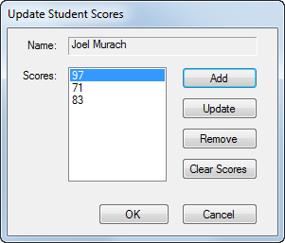
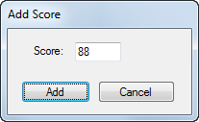
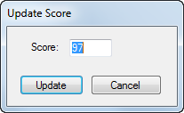
Project 2-2 Maintain student scores (cont.)

